Slide 1
Murach’s PHP and MySQL (4th Edition)
Chapter 11
How to create and use arrays

Slide 2
Objectives
Applied
Use any of the functions and techniques presented in this chapter as you use arrays, associative arrays, and arrays of arrays.
Knowledge
Distinguish between an array and an associative array, including the difference in the way indexes are used.
Explain how gaps can be introduced into an array and how the gaps can be removed.
Describe the use of a for loop with an array and the use of a foreach loop with an associative array.
Describe the use of the spread operator with arrays.
Distinguish between a queue and a stack.

Slide 3
Objectives (continued)
Describe the use of the functions for creating arrays, working with queues and stacks, performing mathematical calculations, searching arrays, sorting arrays, and modifying arrays.
Distinguish between a regular array and an array of arrays, including the difference in the number of indexes that are used to access an element.

Slide 4
The syntax for creating an array
$array_name = [ [value1[, value2] ...] ];
The syntax for referring to an element of an array
$array_name[index];
How to create an array of names
With one statement
$names = ['Ted Lewis', 'Sue Jones', 'Ray Thomas'];
With multiple statements
$names = []; // create an empty array
$names[0] = 'Ted Lewis'; // set three values in the array
$names[1] = 'Sue Jones';
$names[2] = 'Ray Thomas';

Slide 5
How to create an array of discounts
With one statement
$discounts = [0, 5, 10, 15]; // create an array // with four elements
With multiple statements
$discounts = []; // create an empty array
$discounts[0] = 0; // set four values in the array
$discounts[1] = 5;
$discounts[2] = 10;
$discounts[3] = 15;

Slide 6
How to code element values on separate lines
$names = [
'Ted Lewis',
'Sue Jones',
'Ray Thomas'
];
With a trailing comma (PHP 7.2 and later)
$names = [
'Ted Lewis',
'Sue Jones',
'Ray Thomas',
];

Slide 7
How to use the print_r() function to view an array
print_r($names);
// Output: Array ( [0] => Ted Lewis [1] => Sue Jones // [2] => Ray Thomas )
How to define a constant for an array (PHP 7.0 and later)
define('MONTHS', ['Jan', 'Feb', 'Mar']);

Slide 8
The syntax for adding an element to an array
$array_name[] = value;
How to add a value to the end of an array
$letters = ['a', 'b', 'c', 'd']; // a, b, c, d
$letters[] = 'e'; // a, b, c, d, e
How to set a value at a specific index
$letters = ['a', 'b', 'c', 'd']; // a, b, c, d
$letters[0] = 'e'; // e, b, c, d
$letters[3] = 'f'; // e, b, c, f
$letters[5] = 'g'; // e, b, c, f, NULL, g
How to get values from an array
$letters = ['a', 'b', 'c', 'd']; // a, b, c, d
$letter1 = $letters[0]; // $letter1 is 'a'
$letter2 = $letters[1]; // $letter2 is 'b'
$letter4 = $letters[4]; // $letter4 is NULL

Slide 9
Functions for removing the values from elements
unset($var1[, $var2] ...)
array_values($array)
How to delete values from an array
$letters = ['a', 'b', 'c', 'd']; // a, b, c, d
unset($letters[2]); // a, b, NULL, d
unset($letters); // $letters is NULL
How to remove NULL elements and reindex
$letters = ['a', 'b', 'c', 'd']; // a, b, c, d
unset($letters[2]); // a, b, NULL, d
$letters = array_values($letters); // a, b, d
How to use variable substitution with elements
$name = ['Ray', 'Harris'];
echo "First Name: $name[0]"; // First Name: Ray
echo "First Name: {$name[0]}"; // First Name: Ray

Slide 10
Functions for loops that work with arrays
count($array)
array_key_first($array)
array_key_last($array)
isset($var)
Code that stores 10 random numbers in an array
$numbers = [];
for ($i = 0; $i < 10; $i++) {
$numbers[] = mt_rand(1, 100);
}
Code that displays the elements of an array
$numbers_string = '';
for ($i = 0; $i < count($numbers); $i++) {
$numbers_string .= $numbers[$i] . ' ';
}
echo $numbers_string;

Slide 11
Computing the sum and average of an array
$prices = [141.95, 212.95, 411, 10.95];
$sum = 0;
for ($i = 0; $i < count($prices); $i++) {
$sum += $prices[$i];
}
$average = $sum / count($prices);

Slide 12
How to skip gaps in an array
$numbers = [1, 2, 3, 4, 5, 6, 7, 8, 9, 10];
unset($numbers[2], $numbers[6]);
$last = array_key_last($numbers);
$numbers_string = '';
for($i = 0; $i <= $last; $i++) {
if (isset($numbers[$i])) {
$numbers_string .= $numbers[$i] . ' ';
}
}
echo $numbers_string; // displays 1 2 4 5 6 8 9 10

Slide 13
The syntax for creating an associative array
$array_name = [ [key1 => value1, key2 => value2, ... ] ];
How to create an associative array of tax rates
With one statement
$tax_rates = ['NC' => 7.75, 'CA' => 8.25, 'NY' => 8.875];
With multiple statements
$tax_rates = [];
$tax_rates['NC'] = 7.75;
$tax_rates['CA'] = 8.25;
$tax_rates['NY'] = 8.875;

Slide 14
How to create an associative array of codes
With one statement
$country_codes = ['DEU' => 'Germany', 'JPN' => 'Japan’, 'ARG' => 'Argentina', 'USA' => 'United States'];
With elements on separate lines and a trailing comma
$country_codes = [
'DEU' => 'Germany',
'JPN' => 'Japan',
'ARG' => 'Argentina',
'USA' => 'United States',
];

Slide 15
How to create an associative array of extensions
$ext = [];
$ext[10] = 'Sales';
$ext[13] = 'Customer Service';
$ext[16] = 'Returns';
$ext[18] = 'Warehouse';
An array that contains integer and string indexes
$employees = [];
$employees[0] = 'Mike';
$employees[1] = 'Anne';
$employees[2] = 'Judy';
$employees['senior'] = 'Mike';
$employees['newest'] = 'Scott';

Slide 16
How to use the print_r() function to view an associative array
print_r($tax_rates);
// Output: Array ( [NC] => 7.75 [CA] => 8.25 // [NY] => 8.875 )

Slide 17
How to set a value with a specific key
$name = ['first' => 'Ray', 'last' => 'Harris'];
$name['middle'] = 'Thomas';
What happens when you omit the key when adding a value
$name = ['first' => 'Ray', 'last' => 'Harris'];
$name[] = 'Thomas'; // key is 0
How to get a value at a specified key
$name = ['first' => 'Ray', 'last' => 'Harris'];
$first_name = $name['first'];
$last_name = $name['last'];

Slide 18
How to delete values from an array
$name = ['first' => 'Ray', 'last' => 'Harris'];
unset($name['first']); // delete an element's value
unset($name); // delete the array
How to use variable substitution with elements
$name = ['first' => 'Ray', 'last' => 'Harris'];
echo "First Name: $name['first']"; // A parse error
echo "First Name: $name[first]"; // First Name: Ray
echo "First Name: {$name['first']}"; // First Name: Ray

Slide 19
The syntax of a foreach loop
foreach ($array_name as [ $key => ] $value) {
// statements that use $key and $value
}
How to use a foreach loop with a regular array
The array
$prices = [141.95, 212.95, 411, 10.95];
A foreach loop that displays the values in the array
foreach ($prices as $price) {
echo $price . ' | ';
}
// displays 141.95 | 212.95 | 411 | 10.95 |
A foreach loop that displays the indexes and values
foreach ($prices as $index => $price) {
echo $index . ': ' . $price . ' | ';
}
// displays 0: 141.95 | 1: 212.95 | 2: 411 | 3: 10.95 |

Slide 20
How to use a foreach loop with an associative array
The array
$tax_rates = ['NC' => 7.75, 'CA' => 8.25, 'NY' => 8.875];
A foreach loop that displays the values in the array
foreach ($tax_rates as $rate) {
echo $rate . ' | ';
}
// displays 7.75 | 8.25 | 8.875 |
A foreach loop that displays the keys and values
foreach ($tax_rates as $key => $rate) {
echo $key . ': ' . $rate . ' | ';
}
// displays NC: 7.75 | CA: 8.25 | NY: 8.875 |

Slide 21
How to use a foreach loop to skip gaps in an array
$numbers = [1, 2, 3, 4, 5, 6, 7, 8, 9, 10];
unset($numbers[2], $numbers[6]);
$numbers_string = '';
foreach ($numbers as $number) {
$numbers_string .= $number . ' ';
}
echo $numbers_string; // displays 1 2 4 5 6 8 9 10

Slide 22
The spread operator
Operator | Description
... | Add as a prefix to an array to unpack the elements in the array. Works with regular and associative arrays.

Slide 23
How to merge arrays and individual values into a single array
$arr1 = [1, 2, 3];
$arr2 = [6, 7, 8];
$total = [...$arr1, 4, 5, ...$arr2, 9]; // 1, 2, 3, 4, 5, 6, 7, 8, 9
How to merge the values in an associative array
$west = ['WA' => 'Washington', 'OR' => 'Oregon'];
$east = ['NY' => 'New York', 'NJ' => 'New Jersey'];
$states = [...$west, ...$east];
// [WA] => Washington [OR] => Oregon [NY] => New York // [NJ] => New Jersey

Slide 24
How to pass an array to a function that expects individual arguments
function add_three_numbers($num1, $num2, $num3) {
return $num1 + $num2 + $num3;
}
$nums = [10, 20, 30];
$sum = add_three_numbers(...$nums); // 60

Slide 25
How to create a function that accepts a variable number of arguments (variadic function)
function add_numbers(...$nums) {
$total = 0;
foreach($nums as $num) {
$total += $num;
}
return $total;
}
$sum1 = add_numbers(10, 20, 30); // 60
$sum2 = add_numbers(1, 2, 3, 4, 5); // 15
How to pass an array to a variadic function
$nums1 = [10, 20, 30];
$nums2 = [1, 2, 3, 4, 5];
$sum1 = add_numbers(...$nums1); // 60
$sum2 = add_numbers(...$nums2); // 15

Slide 26
Key terms for working with arrays
array
element
index
value
associative array
key
spread operator
variadic function

Slide 27
Functions for creating arrays
range($low, $high [, $step])
array_fill($start, $count, $value)
array_pad($array, $size, $value)
array_merge($array1, $array2, ...)
array_slice($array, $index [, $len [, $keys]])
array_splice($array, $index, $len, $new)

Slide 28
How to create an array that has a range of values
$numbers = range(1, 4); // 1, 2, 3, 4
$numbers = range(10, 22, 4); // 10, 14, 18, 22
How to fill and pad an array
$numbers = array_fill(0, 5, 1); // 1, 1, 1, 1, 1
$numbers = array_pad($numbers, 10, 0); // 1, 1, 1, 1, 1, 0, 0, 0, 0, 0
How to merge two arrays
$employees = ['Mike', 'Anne'];
$new_hires = ['Ray', 'Pren'];
$employees = array_merge($employees, $new_hires);
print_r($employees);
// Array ( [0] => Mike [1] => Anne [2] => Ray
// [3] => Pren )

Slide 29
How to slice one array from another
$employees = ['Mike', 'Anne', 'Ray', 'Pren'];
$new_hires = array_slice($employees, 2);
print_r($new_hires); // Array ( [0] => Ray [1] => Pren )
How to splice two arrays together
$employees = ['Mike', 'Anne', 'Joel'];
$new_hires = ['Ray', 'Pren'];
array_splice($employees, 1, 2, $new_hires);
print_r($employees);
// Array ( [0] => Mike [1] => Ray [2] => Pren )

Slide 30
Functions for checking if a variable is an array
is_array($value)
is_array_list($value)
How to check if a variable is an array
if (is_array($numbers)) {
foreach ($numbers as $num) {
// do something
}
}

Slide 31
Functions for working with queues and stacks
array_push($array, $value)
array_pop($array)
array_unshift($array, $value)
array_shift($array)
How to work with a stack
$names = ['Mike', 'Joel', 'Anne'];
array_push($names, 'Ray'); // Mike, Joel, Anne, Ray
$next = array_pop($names); // Mike, Joel, Anne
echo $next; // displays Ray
How to work with a queue
$names = ['Mike', 'Joel', 'Anne'];
array_push($names, 'Ray'); // Mike, Joel, Anne, Ray
$next = array_shift($names); // Joel, Anne, Ray
echo $next; // displays Mike

Slide 32
Key terms for working with queues and stacks
stack
last-in, first-out (LIFO)
queue
first-in, first-out (FIFO)

Slide 33
Functions for performing mathematical calculations
array_sum($array)
array_product($array)
How to add all values in an array
$prices = [141.95, 212.95, 411, 10.95];
$sum = array_sum($prices); // 776.85

Slide 34
Functions for searching arrays
in_array($value, $array [, $strict])
array_key_exists($key, $array)
array_search($value, $array [, $strict])
array_count_values($array)

Slide 35
How to search an array
$tax_rates = ['NC' => 7.75, 'CA' => 8.25, 'NY' => 8.875];
$is_found = in_array(7.75, $tax_rates); // TRUE
$is_found = in_array('7.75', $tax_rates); // TRUE
$is_found = in_array('7.75', $tax_rates, true); // FALSE
$key_exists = array_key_exists('CA', $tax_rates); // TRUE
$key = array_search(7.75, $tax_rates); // 'NC'

Slide 36
How to count the occurrences of a value in an array
$names = ['Mike', 'Mike', 'Mike',
'Anne', 'Joel', 'Joel'];
$occurences = array_count_values($names);
echo $occurences['Mike']; // 3
echo $occurences['Anne']; // 1
echo $occurences['Joel']; // 2

Slide 37
Functions for sorting arrays
sort($array[, $compare])
rsort($array[, $compare])
asort($array[, $compare])
arsort($array[, $compare])
ksort($array[, $compare])
krsort($array[, $compare])

Slide 38
How to sort strings in ascending order
$names = ['Mike', 'Anne', 'Joel', 'Ray', 'Pren'];
sort($names); // Anne, Joel, Mike, Pren, Ray
How to sort numbers in ascending order
$numbers = [520, '33', 9, '199'];
sort($numbers, SORT_NUMERIC); // 9, 33, 199, 520
How to sort in descending order
$names = ['Mike', 'Anne', 'Joel', 'Ray', 'Pren'];
rsort($names); // Ray, Pren, Mike, Joel, Anne

Slide 39
How to sort an associative array
$tax_rates = ['NC' => 7.75, 'NY' => 8.875, 'CA' => 8.25];
asort($tax_rates);
// ['NC' => 7.75, 'CA' => 8.25, 'NY' => 8.875]
ksort($tax_rates);
// ['CA' => 8.25, 'NC' => 7.75, 'NY' => 8.875]
arsort($tax_rates);
// ['NY' => 8.875, 'CA' => 8.25, 'NC' => 7.75]
krsort($tax_rates);
// ['NY' => 8.875, 'NC' => 7.75, 'CA' => 8.25]

Slide 40
Functions for modifying arrays
array_unique($array[, $compare])
array_reverse($array[, $keys])
shuffle($array)
array_rand($array[, $count])

Slide 41
How to modify an array
$names = ['Mike', 'Mike', 'Mike', 'Anne’,
'Joel', 'Joel'];
$names = array_unique($names); // Mike, Anne, Joel
$names = array_reverse($names); // Joel, Anne, Mike
shuffle($names); // Mike, Joel, Anne (for example)
How to modify an associative array
$tax_rates = ['NC' => 7.75, 'NY' => 8.875,
'CA' => 8.25];
$tax_rates = array_reverse($tax_rates, true);
// ['CA' => 8.25, 'NY' => 8.875, 'NC' => 7.75]
How to get random keys from an array
$names = ['Mike', 'Anne', 'Joel', 'Ray', 'Pren'];
$key = array_rand($names); // 2 (for example)
$names_rand = array_rand($names, 3);
// 0, 1, 3 (for example)

Slide 42
How to shuffle and deal a deck of cards
// Create the deck of cards
$faces = ['2', '3', '4', '5', '6', '7', '8',
'9', 'T', 'J', 'Q', 'K', 'A'];
$suits = ['h', 'd', 'c', 's'];
$cards = [];
foreach($faces as $face) {
foreach($suits as $suit) {
$cards[] = $face . $suit;
}
}
// Shuffle the deck and deal the cards
shuffle($cards);
$hand = [];
for ($i = 0; $i < 5; $i++) {
$hand[] = array_pop($cards);
}
echo implode(',', $hand); // 9c,6d,Ks,4c,7h (for example)

Slide 43
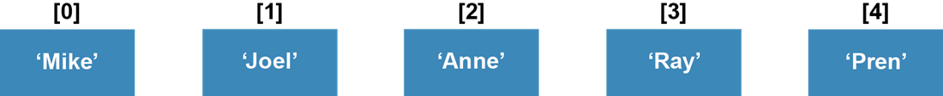
A simple array

Slide 44
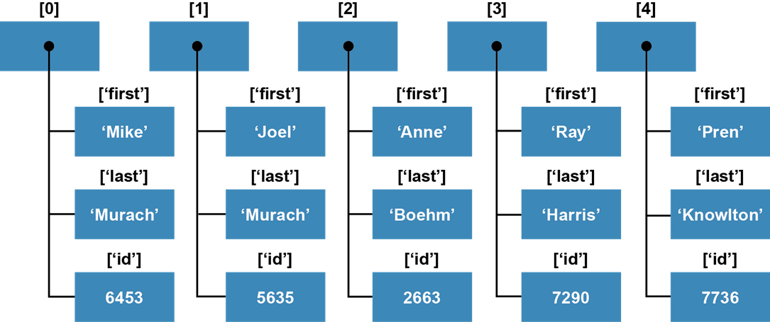
A rectangular array

Slide 45
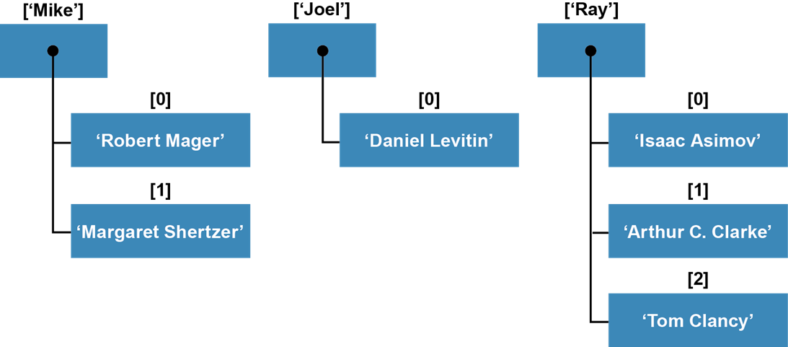
A jagged array

Slide 46
Key terms related to an array of arrays
two-dimensional array
rectangular array
jagged array

Slide 47
Code that creates an array of arrays
$times_table = []; // create an empty array
for ($i = 0; $i <= 12; $i++) { // add 13 elements that
$times_table[$i] = []; // contain empty arrays
}
Code that adds values to the array of arrays
for ($i = 0; $i <= 12; $i++) {
for ($j = 0; $j <= 12; $j++) {
$times_table[$i][$j] = $i * $j;
}
}
Code that refers to elements in the array of arrays
echo $times_table[4][3]; // displays 12
echo $times_table[7][6]; // displays 42

Slide 48
Code that creates a cart array
$cart = [];
Adding an associative array to the cart array
$item = []; // create an empty item array
$item['itemCode'] = 123;
$item['itemName'] = 'HTML and CSS';
$item['itemCost'] = 59.5;
$item['itemQuantity'] = 5;
$cart[] = $item; // add item array to cart array
Adding another associative array to the cart array
$item = []; // create an empty item array
$item['itemCode'] = 456;
$item['itemName'] = 'Java';
$item['itemCost'] = 52.5;
$item['itemQuantity'] = 2;
$cart[] = $item; // add item array to cart array

Slide 49
Referring to the elements in the array of arrays
echo $cart[0]['itemCode']; // displays 123
echo $cart[1]['itemName']; // displays Java

Slide 50
A more concise way to create an array of arrays
$cart = [
['itemCode' => 123, 'itemName' => 'HTML and CSS',
'itemCost' => 59.5, 'itemQuantity' => 5],
['itemCode' => 456, 'itemName' => 'Java',
'itemCost' => 52.5, 'itemQuantity' => 2],
];

Slide 51
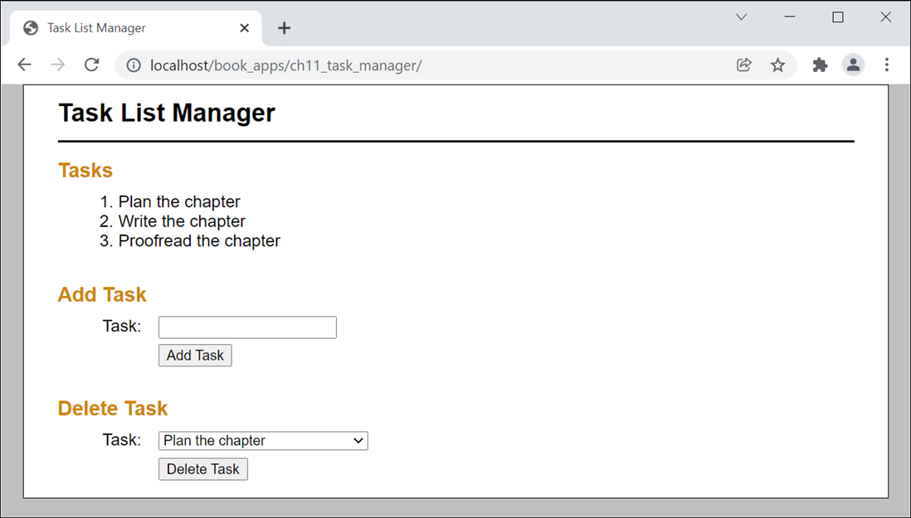
The Task List Manager application

Slide 52
The index.php file (part 1)
<?php
$task_list = filter_input(INPUT_POST, 'tasklist',
FILTER_DEFAULT,
FILTER_REQUIRE_ARRAY);
if ($task_list === NULL) {
$task_list = [];
}
$action = filter_input(INPUT_POST, 'action');
$errors = [];

Slide 53
The index.php file (part 2)
switch( $action ) {
case 'add':
$new_task = filter_input(INPUT_POST, 'task');
if (empty($new_task)) {
$errors[] = 'The new task cannot be empty.';
} else {
$task_list[] = $new_task;
}
break;
case 'delete':
$task_index = filter_input(INPUT_POST, 'taskid',
FILTER_VALIDATE_INT);
if ($task_index === NULL || $task_index === FALSE) {
$errors[] = 'The task cannot be deleted.';
} else {
unset($task_list[$task_index]);
$task_list = array_values($task_list);
}
break;
}
include('task_list.php');
?>

Slide 54
The task_list.php file (part 1)
<!DOCTYPE html>
<html>
<head>
<title>Task List Manager</title>
<link rel="stylesheet" href="main.css">
</head>
<body>
<header>
<h1>Task List Manager</h1>
</header>
<main>
<!-- part 1: the errors -->
<?php if (is_array($errors) && count($errors) > 0) : ?>
<h2>Errors</h2>
<ul>
<?php foreach($errors as $error) : ?>
<li><?php echo htmlspecialchars($error); ?></li>
<?php endforeach; ?>
</ul>
<?php endif; ?>

Slide 55
The task_list.php file (part 2)
<!-- part 2: the tasks -->
<h2>Tasks</h2>
<?php if (is_array($task_list) &&
count($task_list) > 0) : ?>
<ul>
<?php foreach( $task_list as $id => $task ) : ?>
<li><?php echo $id + 1 . '. ' .
htmlspecialchars($task); ?></li>
<?php endforeach; ?>
</ul>
<?php else: ?>
<p>There are no tasks in the task list.</p>
<?php endif; ?>
<br>

Slide 56
The task_list.php file (part 3)
<!-- part 3: the add form -->
<h2>Add Task</h2>
<form action="." method="post" >
<?php if (is_array($task_list) &&
count($task_list) > 0) : ?>
<?php foreach( $task_list as $task ) : ?>
<input type="hidden" name="tasklist[]"
value="<?php echo htmlspecialchars($task); ?>">
<?php endforeach; ?>
<?php endif; ?>
<input type="hidden" name="action" value="add">
<label>Task:</label>
<input type="text" name="task"><br>
<label>&nbsp;</label>
<input type="submit" value="Add Task"><br>
</form>
<br>

Slide 57
The task_list.php file (part 4)
<!-- part 4: the delete form -->
<?php if (is_array($task_list) &&
count($task_list) > 0) : ?>
<h2>Delete Task</h2>
<form action="." method="post" >
<?php foreach( $task_list as $task ) : ?>
<input type="hidden" name="tasklist[]"
value="<?php echo htmlspecialchars($task); ?>">
<?php endforeach; ?>
<input type="hidden" name="action" value="delete">
<label>Task:</label>
<select name="taskid">
<?php foreach( $task_list as $id => $task ) : ?>
<option value="<?php echo $id; ?>">
<?php echo htmlspecialchars($task); ?>
</option>
<?php endforeach; ?>
</select>
<br>
<label>&nbsp;</label>
<input type="submit" value="Delete Task">
</form>
<?php endif; ?>
</main>
</body>
</html>

